Slide 1
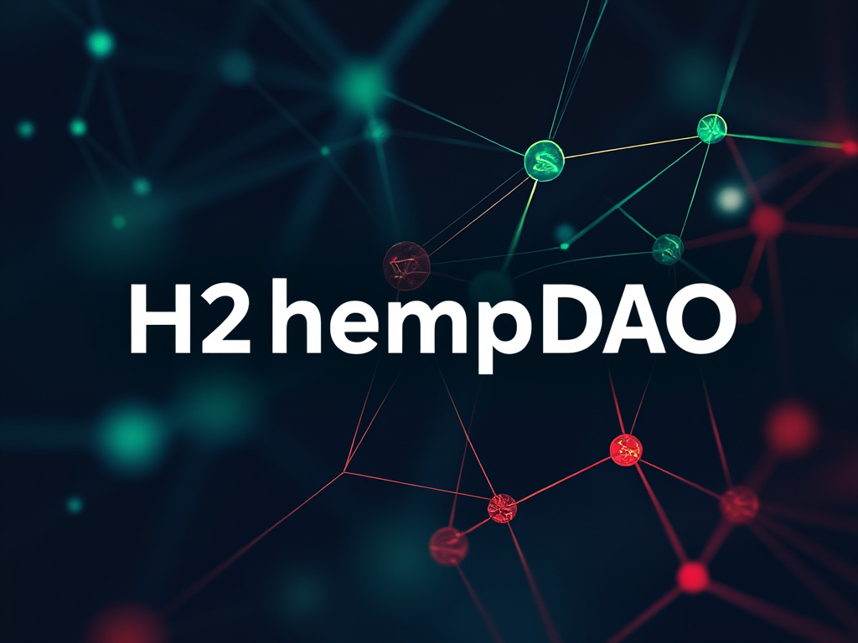
Business Plan for Building the Future Cannabis Agriculture Community with Blockchain and AI Robots

Slide 2
What problem do we solve, and why should we do this company (pain points and needs, problems thatusers must solve)?
We solve the problem that ordinary people cannot grasp professional cannabis cultivation techniques. By utilizing artificial intelligence and hydroponic robot technology to control the cannabis cultivation process, we enable every ordinary household to become agricultural cultivation experts. This approach not only addresses the issue of homegrown cannabis cultivation but also promotes the development of decentralized community agriculture.

Slide 3
Your target customers, what kind of customers will buy your products, why buy them (positioning focus)
Our target customers are ordinary cannabis consumers who find market prices too high and consider home cultivation overly complex due to the need for professional management techniques. Through our AI hydroponic robot system, households can create a decentralized home cannabis farm, easily growing professional-quality cannabis with minimal costs—only time and water are required. Utilizing blockchain technology, users can have full control over their farms and participate in a decentralized community, sharing resources and making decisions through smart contracts. This solution offers a long-term, low-cost, high-value investment opportunity, combining AI and blockchain technology to fundamentally change the way home cannabis cultivation is done. Together, we can build the future of home agricultural communities.

Slide 4
How big is the market, how big is the potential market, and how do we meet this market?
New Frontier Data Projects projects annual U.S. legal cannabis sales to exceed $57 billion by 2030 (a CAGR of 14%) in current legal states, and if the 18 additional state markets poised to legalize activate, this figure would top $72 billion.
U.S. Cannabis Sales to More $72B by 2030 https://www.globenewswire.com/en/news-release/2022/03/23/2408755/0/en/New-Frontier-Data-Projects-Annual-U-S-Cannabis-Sales-to-More-Than-Double-to-72B-by-2030.html
According to Databridge market analysis and forecasts, the global cannabis market was valued at $25.4 billion as of 2021. They further predict that the global cannabis market will reach a value of $168.58 billion by 2029. It is projected to grow at a compound annual growth rate of 9% during the forecast period from 2022 to 2029.In the global cannabis market, countries such as the United States, Canada, Mexico, Uruguay, the Netherlands, Germany, Sweden, Denmark, Israel, Australia, and Thailand are considered to be the most important markets for compound growth.
Databridge market https://www.databridgemarketresearch.com/reports/global-cannabis-market
Data indicates that by 2030, the cultivation market in the United States is projected to reach $72 billion, with a global scale expected to reach $170 billion. We are among the few companies in the market integrating generative artificial intelligence and automated hydroponic robot technologies. Additionally, we offer various marketing models, enabling users to acquire equipment for as low as $0 to meet diverse user needs.
Our goal is to capture 1% of the market share and become an AI cultivation robotics company valued at several billion dollars.
By joining our decentralized community(H2hempDAO), users can not only grow crops on our alliance community platform but also participate in community decision-making and governance through blockchain technology, earning dual benefits—cultivation assets and digital assets.

Slide 5
Why now, why is it now, why hasn't anyone solved this problem before, and why can it be solved now
Now is the time to address this issue due to changes in policies and technologies. In recent years, with the introduction of policies in the European Union and North American countries, cannabis cultivation and recreational use have been widely accepted, enabling ordinary households to grow and use cannabis at home. Additionally, the flourishing development of decentralized blockchain technology provides strong support for this trend, allowing users to securely record and share their cultivation data. At the same time, technological breakthroughs have made generative artificial intelligence possible, allowing robots to better understand, learn, and control the cannabis cultivation process through visual recognition. This change enables ordinary individuals to cultivate professional-quality cannabis at home.

Slide 6
Why Me, why you, why can you succeed, why are you the lucky one (what makes you special)
Entrepreneurship is a process that requires the integration of different resources, including technology, funds, market, personnel, and solving different problems throughout this process. It also requires ensuring that the project team consistently moves towards the goal. We must have clear goals, match out exceptional resources to ensure the long-term effective implementation of the project. Additionally, possessing excellent communication skills to convince various resource providers and achieve consensus is essential. Finally, a strong sense of mission is a core factor in our success.
Our entrepreneurial team possesses these comprehensive factors, and we believe they enable us to successfully address various challenges throughout the entrepreneurial journey and ultimately achieve success in the market.

Slide 7
Marketing model, how to promote the product
Our core marketing philosophy is to ensure long-term affordability for users. Our marketing model includes utilizing the internet for promotion and sales, as well as reaching target customers through social media accounts, Amazon, Walmart, cannabis associations, and exhibitions. We also offer a zero down payment or experiential consumption shopping model to maximize benefits for users.
By developing a decentralized cannabis agricultural community for marketing, we can leverage blockchain technology to enhance user engagement and trust. Decentralized communities enable users to participate in project governance and decision-making through a DAO model, increasing user loyalty and sense of belonging. Additionally, users can earn economic rewards through staking and mining, further boosting their participation. The decentralized community not only enhances the transparency of the project but also provides users with the opportunity to gain dual asset benefits (cultivation assets and digital assets) through community involvement.

Slide 8
Earning model
Our profit model is solid and reliable, integrating traditional sales strategies with innovative community engagement, while further enhancing its credibility and sustainability through the unique mechanism of the DAO-based decentralized home cannabis cultivation community. Beyond traditional retail channels, we have built a decentralized home cultivation network, making us stand out in the industry. With DAO governance, users not only participate in resource sharing and project development within the community but also take part in decision-making, enhancing their sense of involvement and creating tangible value.
In this network, users can acquire cultivation equipment with zero upfront costs, lowering the entry barrier and attracting more participants. Once users successfully cultivate cannabis using our advanced equipment, they can sell their harvest through our decentralized, secure, and efficient platform, earning substantial profits. The DAO mechanism ensures that all transactions and profit distributions are conducted transparently and with trust, motivating users to actively engage while also ensuring a stable supply of high-quality cannabis products on the platform.
Additionally, H2HempDAO introduces a crypto asset staking and mining mechanism, allowing users to earn extra rewards by staking tokens, further boosting community participation and economic returns. This mechanism not only enhances user engagement but also brings increased liquidity and long-term support for the platform.
By fostering deep user involvement in production, governance, and staking, we have built a loyal and highly active decentralized community, achieving a win-win situation between H2Hemp and its users. Moreover, this innovative model combines DAO governance, cutting-edge AI cultivation technology, and best cultivation practices to maximize yield and quality, further enhancing our profitability, diversifying our product offerings, and strengthening our market position.
Overall, our profit model is not only credible but also highly scalable. By empowering the decentralized community, H2HempDAO drives mutual success for the company and its users, offering dual benefits of cultivation assets and digital assets, providing a unique experience of both cultivation and crypto asset growth.

Slide 9
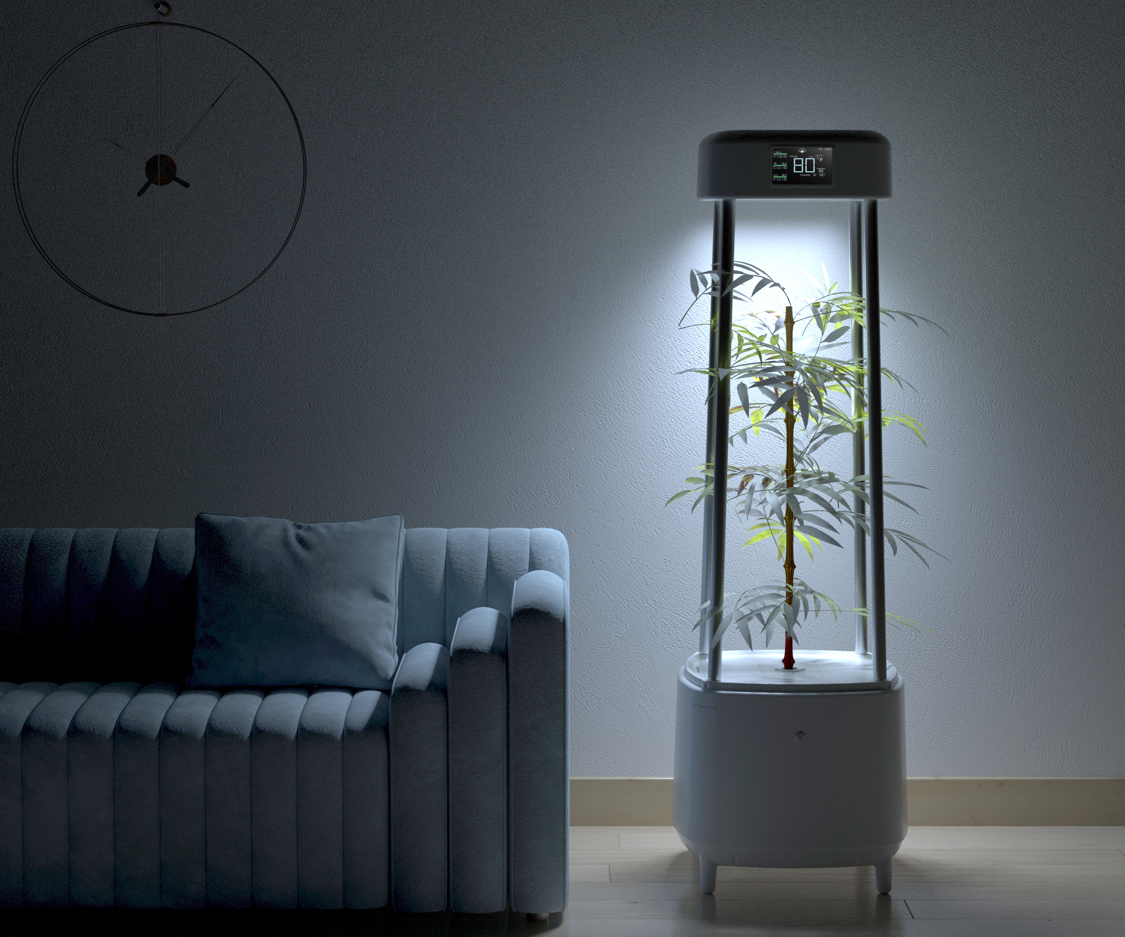
Our Product
Our product name is "H2-Rise”
Product Overview:
H2-Rise is our first fully automatic home hydroponic robot system equipped with generative AI technology. It achieves automatic control through AI, customizes growth plans, and adjusts temperature, humidity, and carbon dioxide levels. This fully automated system offers seamless control through a user-friendly mobile app, enabling precise adjustments of temperature, humidity, CO2 levels, and full-spectrum LED lighting. With H2-Rise, you can effortlessly cultivate hemp flowers and leaves within approximately 90 days, yielding around 2 ounces of premium buds, while ensuring an impressive 100% seed germination rate.
Additionally, after each successful harvest every 90 days, the system will automatically generate a unique NFT as a record of your cultivation achievements. Users can stake this NFT to participate in the platform's mining mechanism, further earning digital asset rewards and realizing dual returns from both cultivation and the blockchain economy.
Features include:
Advanced AI-driven hydroponic system
Pofi ring light device with integrated odor management capabilities
Bean pods, culture medium, and humidity dome for optimal plant growth
AI-powered visual depth growth algorithm for enhanced cultivation
Comprehensive full-spectrum lighting system
Precise sensing system for monitoring temperature, humidity, CO2 levels, and water environment
Efficient hydroponic nutrient management system
NFT cultivation success generation system
crypte staking and mining system

Slide 10
H2HempDAO: Vision and Mission
H2HempDAO is committed to advancing the future of smart agriculture through blockchain, artificial intelligence, and robotics technology. Our vision is to create a decentralized home-based smart agricultural community, enabling every household to easily own their own intelligent cultivation system and reduce dependence on high market prices. With AI-powered hydroponic robots, users can grow cannabis or other crops at home sustainably and at a low cost without needing professional cultivation skills, turning ordinary households into cultivation experts.
We believe that the future of agriculture will be driven by intelligent technology. H2HempDAO empowers every participant with autonomy and control over future agriculture through automated hydroponic robots and decentralized community governance. Here, users can not only reap the economic benefits of cannabis cultivation but also earn digital assets through token staking and community governance. H2HempDAO will revolutionize traditional agriculture, promote sustainable development, and integrate cultivation assets and digital assets into the core of family wealth, becoming an essential part of future household assets. Join H2HempDAO and help build a decentralized agricultural community that leads the future of smart agriculture.

Slide 11
H2hemp Robotics.Inc
Yanming Guo
Add: 78 John Miller Way Ste 326, Kearny, NJ 07032
Mail: H2hemprobotics@Gmail.com,Info@H2hemp.com
WEB: www.H2hemp.com

